Slide 1
Graph Coloring for Efficient Code Compilation
Andrew Erickson, Ethan Rapa, Haven Cook
CSCI | 10/22/2025

Slide 2
Agenda
Background
What is Graph Coloring?
Interference graphs?
Current Status
Next Steps

Slide 3
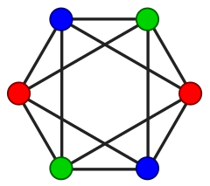
What is Graph Coloring?
Graph coloring assigns colors (labels) to nodes of a graph so that no two adjacent nodes share the same color.
It’s an NP-hard combinatorial optimization problem.
Applications:
Register allocation in compilers, Scheduling tasks, Frequency assignment, etc
Goal:
Minimize number of colors (chromatic number)
Ensure no adjacent nodes conflict
Notes:
What is graph coloring? Graph coloring is one of the fundamental problems in computer science and optimization.
The idea is simple: we assign colors to nodes so that no two connected nodes share the same color.
But finding the minimum number of colors is actually NP-hard, which means it quickly becomes computationally infeasible for large graphs.
Despite its simplicity, graph coloring has many practical applications—from compiler design and scheduling to network frequency assignment.
So understanding how to color graphs efficiently is still a very active area of research.

Slide 4
What are Interference Graphs?
Interference Graphs:
Nodes = program variables
Edge = variables live at the same time (cannot share register)
Register Reallocation:
Each color corresponds to a machine register
Goal: assign registers without conflict
If registers are limited → spilling to memory occur
Notes:
This is where graph coloring shows up in real systems — in compilers.
During code compilation, each variable in the program must be stored in a processor register when it’s active.
Two variables that are live at the same time interfere with each other, so they can’t share a register.
We can represent this relationship with an interference graph — where edges show conflicts.
Then, we color this graph so that no two connected nodes share the same color, and each color corresponds to a CPU register.
If we run out of colors, some variables get spilled to memory, which slows down performance.
So an efficient coloring means faster compiled code.
In other words, if we have an arbitrary code to compile and some CPU architecture with K registers, can the code’s active variables fit into it’s available registers

Slide 5
Experiment
Objective:
Meta-study of graph coloring algorithms:
Compare advantages, disadvantages, execution speed, solution quality, training time
Explore learning-based approaches using GNNs and Graph Transformers
Research Question:
Can a GNN or Graph Transformer learn graph structure to find faster or more optimal colorings?
Notes:
Our experiment is essentially a meta-study — meaning we’re not inventing a new algorithm, but rather evaluating existing ones.
We’ll start by comparing traditional graph coloring heuristics, like Greedy and D-SATUR, and measure their execution times and solution quality.
Then, we’ll explore recent machine learning approaches — particularly Graph Neural Networks and Graph Transformers.
The question we want to answer is: can a neural network learn enough structure from graphs to produce better or faster colorings than classical methods?
Ultimately, the goal is to understand whether ML-based models can generalize to unseen graphs and provide a real advantage in practice.

Slide 6
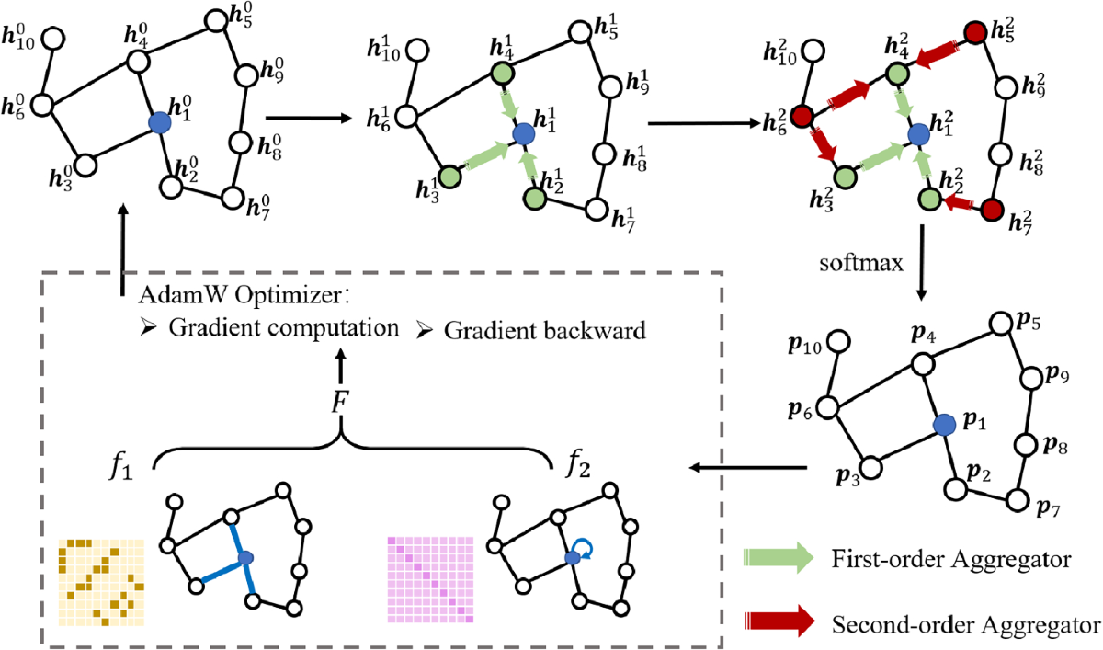
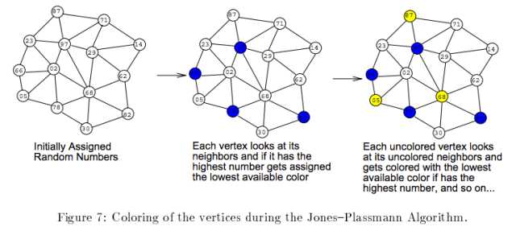
Current Status
Models identified and acquired:
GNN
RNN
Non-NN algorithms:
Independent sets
Greedy coloring
Notes:
At this point in time, we have gathered papers that outline a GNN architecture and an RNN architecture. We have cloned the GNN paper’s repo and recreated their results in a test environment, but have not done the same for the RNN. Additionally, we have access to standard implementations of normal graph coloring algorithms. These generally fall into two categories, either using priorities to determine independent sets of vertices, and coloring accordingly, or serial greedy coloring, which simply iterates through all vertices and assigns each one the lowest color it can.

Slide 7
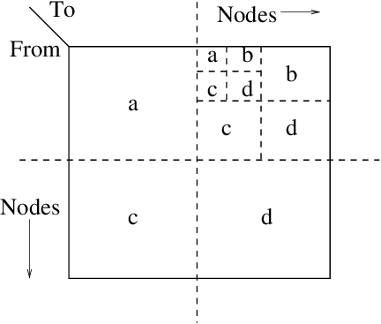
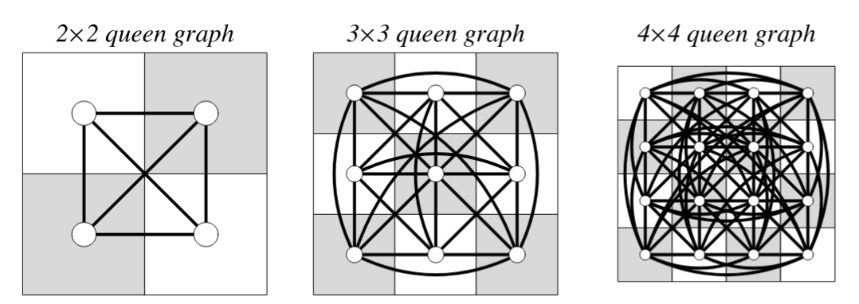
Current Status
Datasets:
Carnegie Mellon graph repository
R-MAT/Erdös-Renyí random graph generation
Specific to our focus:
Program → interference graph generators
Notes:
There are not all that many chromatic number labeled datasets out there, but Carnegie Mellon University hosts a repository of graphs with corresponding known chromatic numbers. These are an excellent starting point for use as training data, as well as verification of correctness. Additionally, we will introduce graphs generated through two processes, R-MAT recursion, which tends to model connected components in a more realistic way, and Erdos-Renyi, which is much simpler, and just represents random, independent connections between vertices. These graphs will need their chromatic numbers found in order to use as training data. Finally, we plan to develop a generator for the interference graphs mentioned previously from program source files.

Slide 8
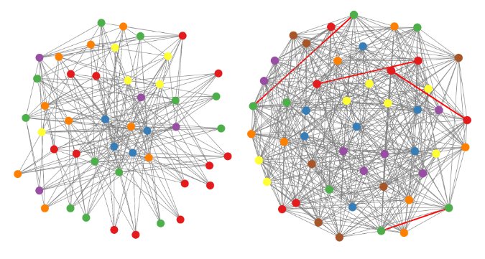
Current Status
Metrics:
Execution time
Coloring quality (number of colors needed)
NN Specific:
Training overhead
Correctness
Notes:
In order to measure the effectiveness of a given graph coloring algorithm, two metrics are of importance: execution time, whose benefit is obvious, and coloring quality. Because of the problems NP-hardness, approximations are all that can be reasonably expected as outputs, and as such, the fewer colors needed to produce a graph coloring, the better. Specific to neural network implementations, we need to keep track of training overhead, and factor that into execution time in order to make a holistic determination of effectiveness. Additionally, neural networks can produce incorrect results, and this means that verification of correctness is necessary.

Slide 9
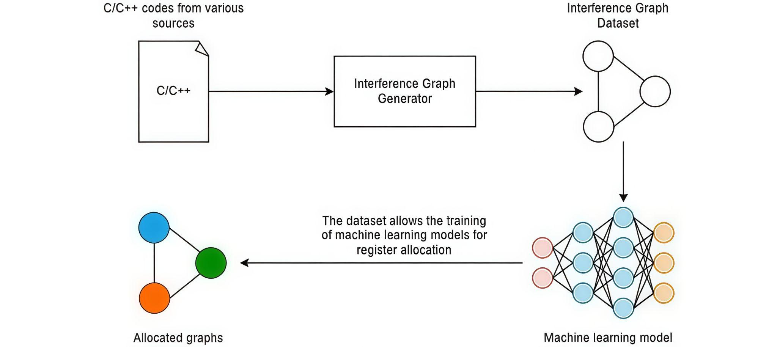
Next Steps: Interference Graph
Notes:
Via our literature review, we have explored what is currently out there, allowing us to focus in on techniques that work. Above is a generalized workflow for deep graph coloring for register allocation. While we wish to reimplement this entire workflow– generating our own data and training our own model– we will also play by ear and revisit our aims at the end of the semester.

Slide 10
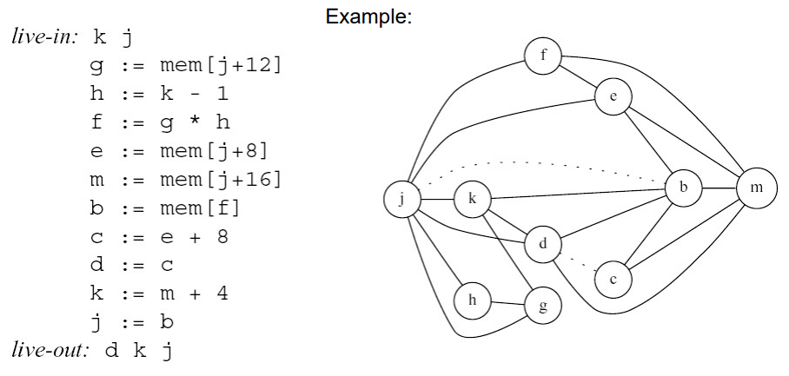
Next Steps: Interference Graph
Notes:
We remember what the interference graph describes: Neighboring nodes must remain in the active set and therefore must be placed on separate registers (colors)
Ex. j is active the entire time and will likely need a dedicated register

Slide 11
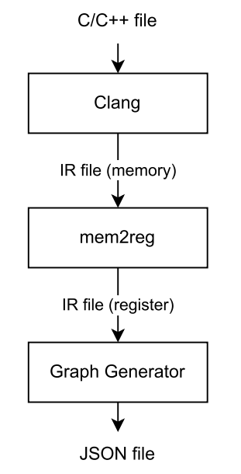
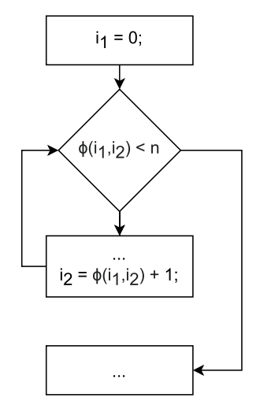
Interference Graph Construction
LLVM generates an IR file
Uses static single assignment (SSA).
Virtual registers assigned only once
Registers that overlap receive an edge
φ-Nodes collect additional information about spill cost
Indicate what can share registers in loops
Notes:
You are welcome to move this to background
Using LLVM will allow us to generate our own interference graph dataset. LLVM generates readable intermediate representation files while using static single assignment (generates virtual registers which cannot be reassigned)
This simplifies what instructions are overlapping when, and these virtual registers are the nodes in our graph. Any registers that are active in the same instruction receive an edge
Therefore we can use this knowledge to generate interference graphs from instruction datasets.

Slide 12
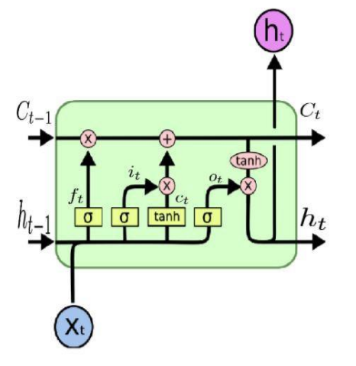
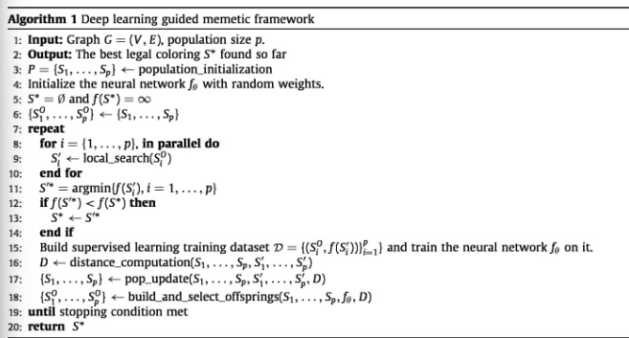
TODO List
Continue searching for existing deep coloring methods
LSTM graph coloring shows promise
Implement standard and naive graph coloring algorithms as baseline
Design, train, and evaluate supervised models (Adopt current GNN models)
Notes:
After completing our immediate aim, we plan on further exploring generated works.
We were slightly disappointed in what we found, with some papers even criticizing GNN use in graph coloring
However, LSTM (a form of RNN) has shown promise ht short-term memory (previous hidden state), ct long-term memory (previous cell state)
xₜ – the input vector at time t. This is the data entering the LSTM at the current step, such as a word embedding or feature vector.
hₜ₋₁ – the previous hidden state. This represents the short-term memory passed from the previous time step and carries recent contextual information.
Cₜ₋₁ – the previous cell state. This is the long-term memory that persists across many time steps, allowing the LSTM to remember older information.
fₜ – the forget gate. This gate decides how much of the old cell state (Cₜ₋₁) should be kept or forgotten.
iₜ – the input gate. This determines how much new information should be written into the cell state.
C̃ₜ – the candidate cell content. This is the new candidate information proposed to be added to the memory, typically passed through a tanh activation.
Cₜ – the updated cell state. This combines the retained old memory and the new candidate input to form the new “memory” of the network.
oₜ – the output gate. This gate controls how much of the cell state’s information should be visible as the output for this time step.
hₜ – the new hidden state. This is both the current output and the short-term memory passed to the next time step or next layer.

